Slide 1

Discussion about
“Diagnostic Session Control (DSC) and Security Access (SecA)”
Internal | Fixed-Term Tuan Phan Hoang Anh (RBVH/EJV23) | 9/3/2021.

Slide 2
I. Service ID 0x10
Diagnostic session control
Internal | Fixed-Term Tuan Phan Hoang Anh (RBVH/EJV23) | 9/3/2021.

Slide 3
Agenda
1. Service Description
2. Format request and response
3. NRC
4. Example

Slide 4
1. Service Description
SID$10 is used to enable different diagnostic sessions in the server(s)
SID$10 changes the operating session of an ECU in order to allow diagnostic services.
Depending on which session is active, different services are available

Slide 5
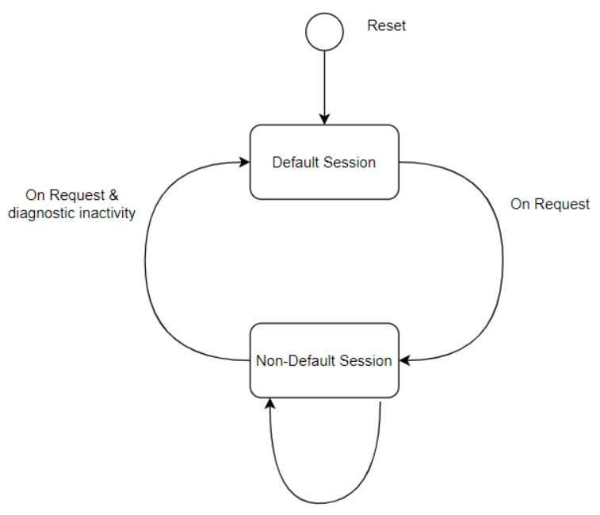
1. Service Description
The Session transition state diagram:
A server shall always start the default diagnostic session when powered up.
If no other diagnostic session started, then the default diagnostic session will be running as long as the server is powered.
There shall be only one session active at a time.

Slide 6
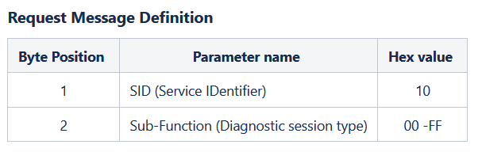
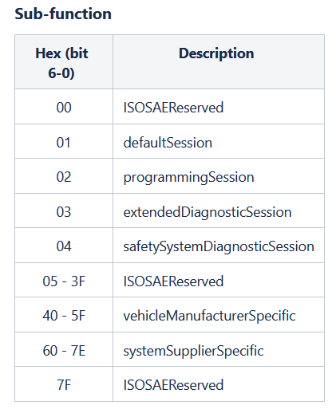
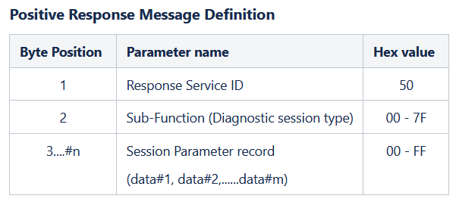
2. Format request and response

Slide 7
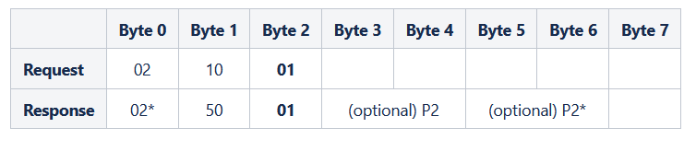
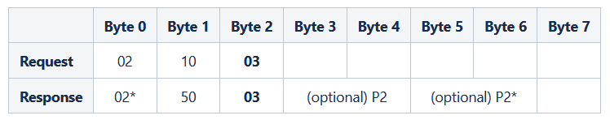
2. Format request and response
Default Session - 0x01
Extended Diagnostic Session - 0x03
P2 and P2* are optional performance timers that define the maximum response time of the ECU to a request during an active diagnostic session
P2 is the maximum time which the ECU has to respond to an initial request (e.g. 40 ms) - if the actual response is not ready, the ECU must respond with a special negative response code (NRC) 0x78
P2* is the maximum time which the ECU has to respond with the actual response or another NRC 0x78 (e.g. 2 s) - the timer begins counting after the last NRC 0x78 response

Slide 8
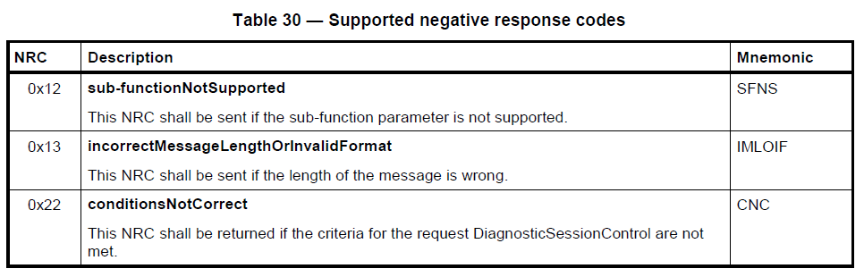
3. NRC

Slide 9
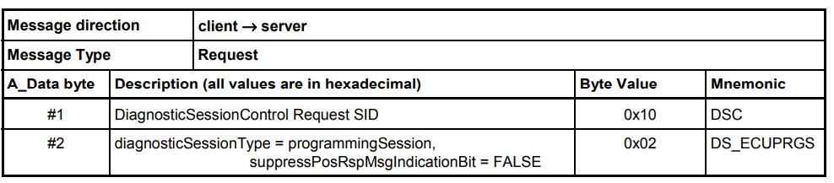
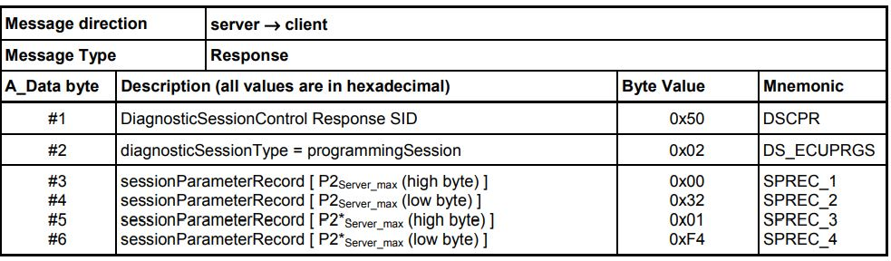
4. Example
Start programmingSession
This message flow shows how to enable the diagnostic session "programmingSession" in a server. For the given example it is assumed that the P2Server_max is equal to 50 ms and the P2*Server_max is equal to 5 000 ms.

Slide 10
II. Service ID 0x27
Security Access
Internal | Fixed-Term Tuan Phan Hoang Anh (RBVH/EJV23) | 9/3/2021.

Slide 11
Agenda
1. Service Description
2. Format request and response
3. NRC

Slide 12
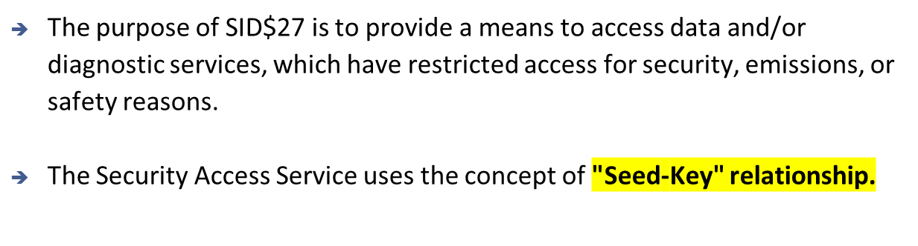
1. Service Description

Slide 13

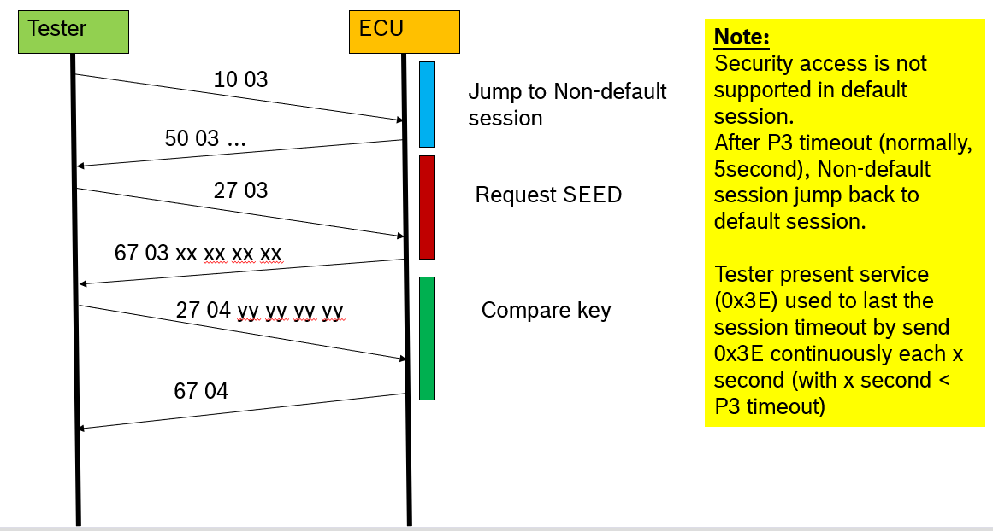
Security access flow

Slide 14
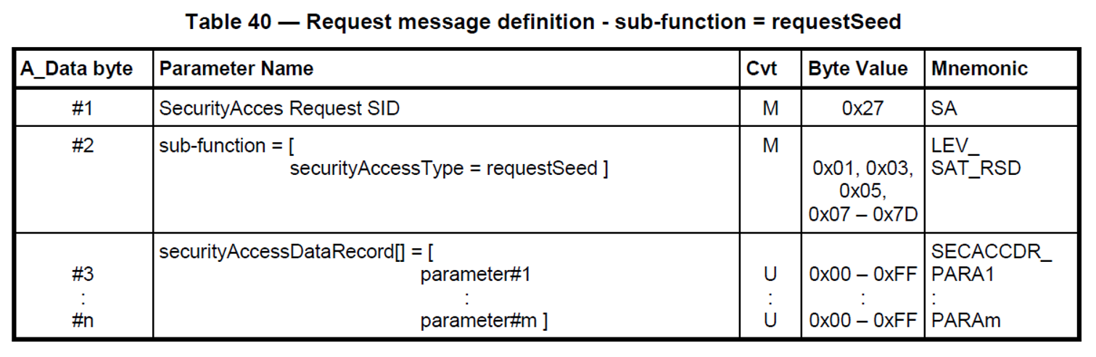
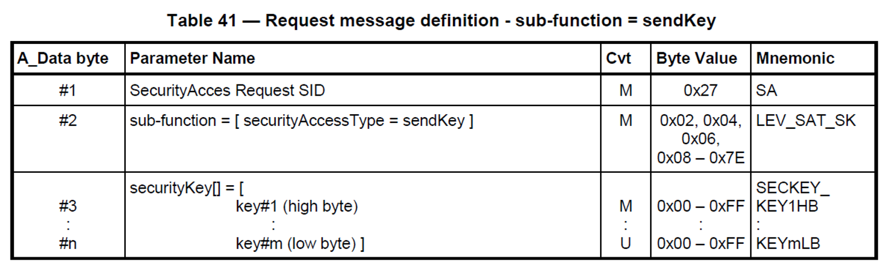
2. Format request and response
Request Seed
Send Key

Slide 15
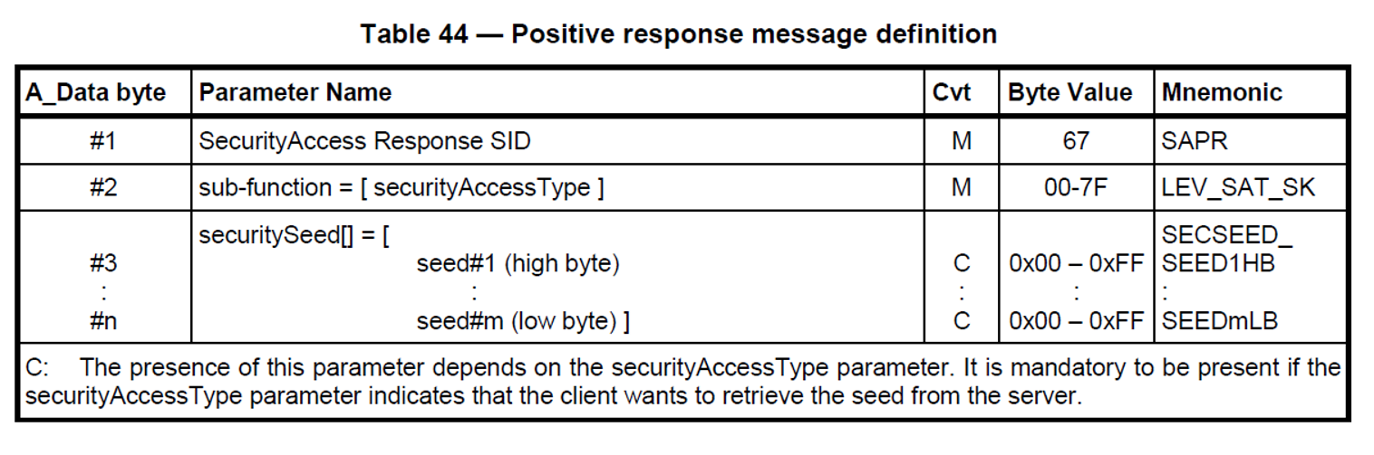
2. Format request and response
Positive response
To get seed:
27 03 ---> request to ECU
67 03 xx xx xx xx ---> response from ECU
To send key:
27 04 yy yy yy yy ---> request to ECU
67 04 ---> response from ECU
Example

Slide 16
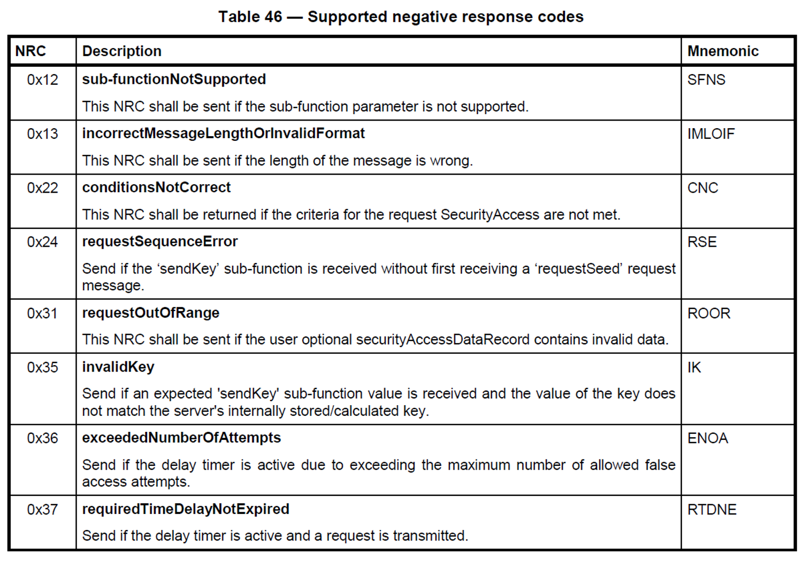
3. NRC

Slide 17
https://inside-docupedia.bosch.com/confluence/pages/viewpage.action?pageId=1530506305 https://inside-docupedia.bosch.com/confluence/pages/viewpage.action?pageId=2356650003
Service_0x27.pptx (From a Danh-san)
Reference
Internal | Fixed-Term Tuan Phan Hoang Anh (RBVH/EJV23) | 9/3/2021.

